Slide 1
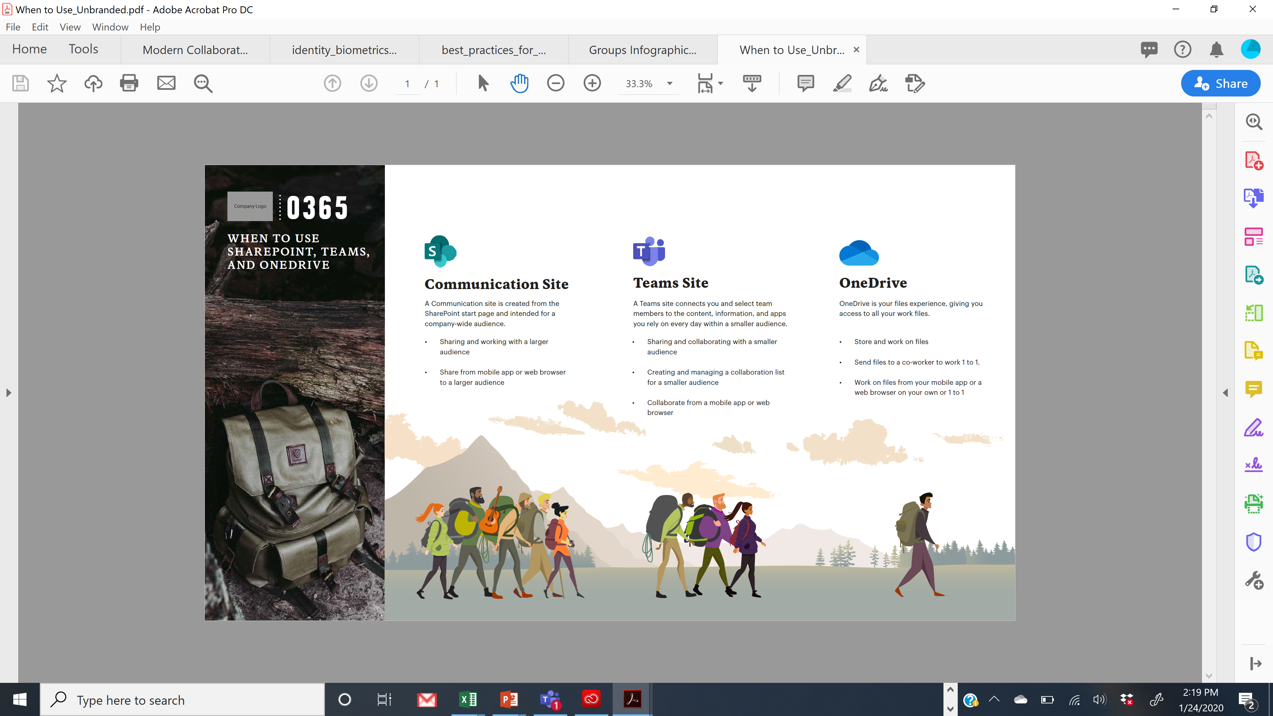
Leading Outdoor Retailer User Adoption Initiative
Business Need
A leading outdoor retailer asked for assistance in creating content to drive adoption, awareness, and training initiatives to onboard staff to the SPO platform migration and MS Office 365. Users were confused about when to use one app versus another.
The Change Management Team pitched a visual design and narrative that places the user in the center, telling them which application will help them get their work done.
What We Did
We created a mix of content to address their needs including infographics, web pages to stock a migration portal and educational portal, and training seminars built on an adult learning model.

Slide 2
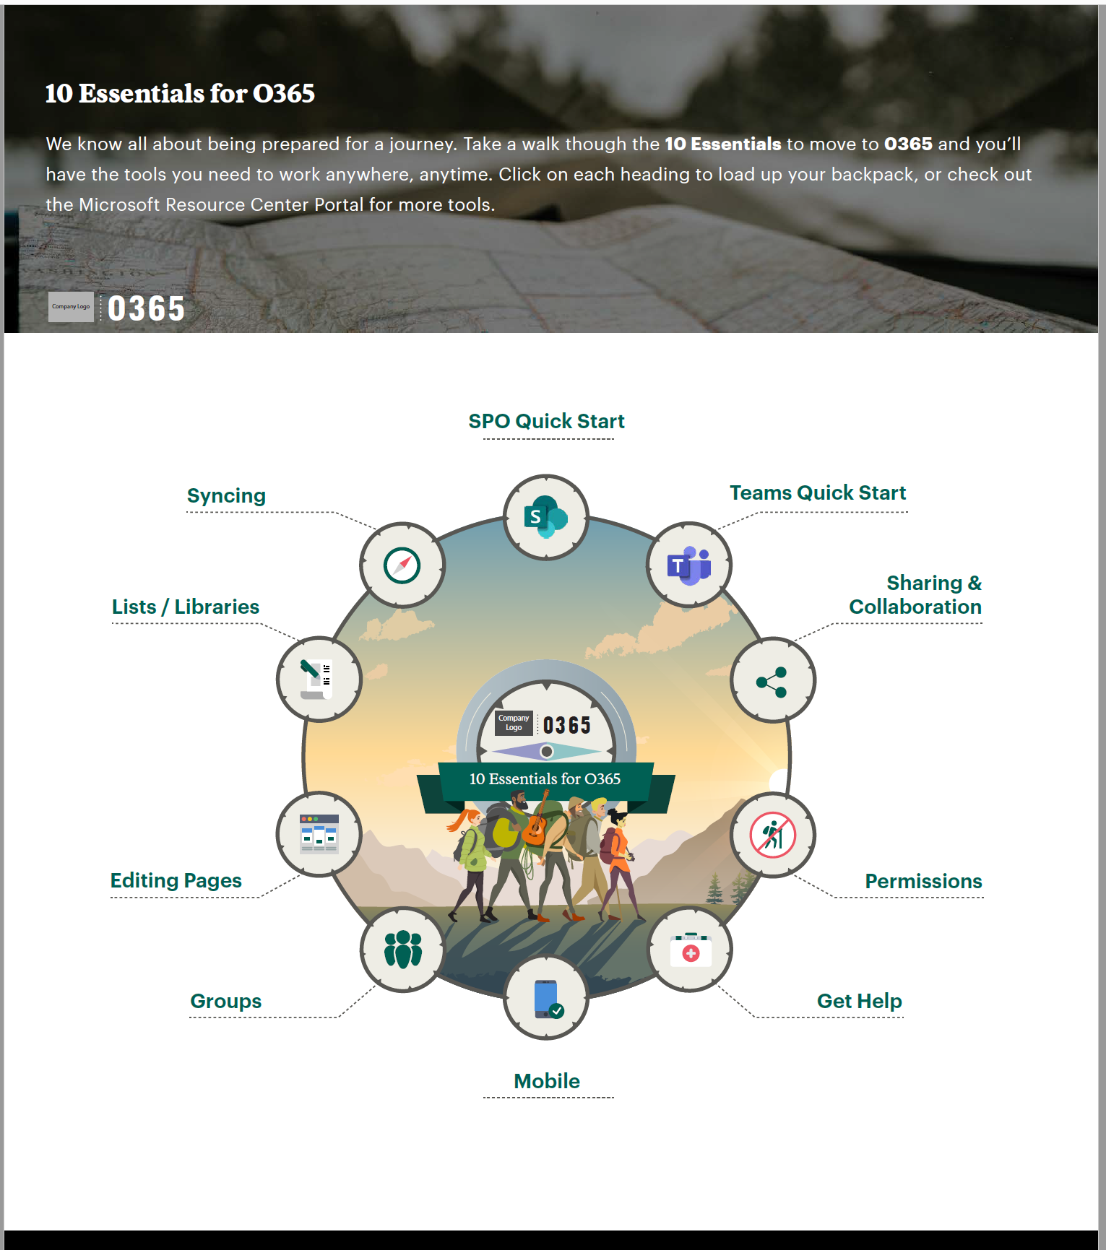
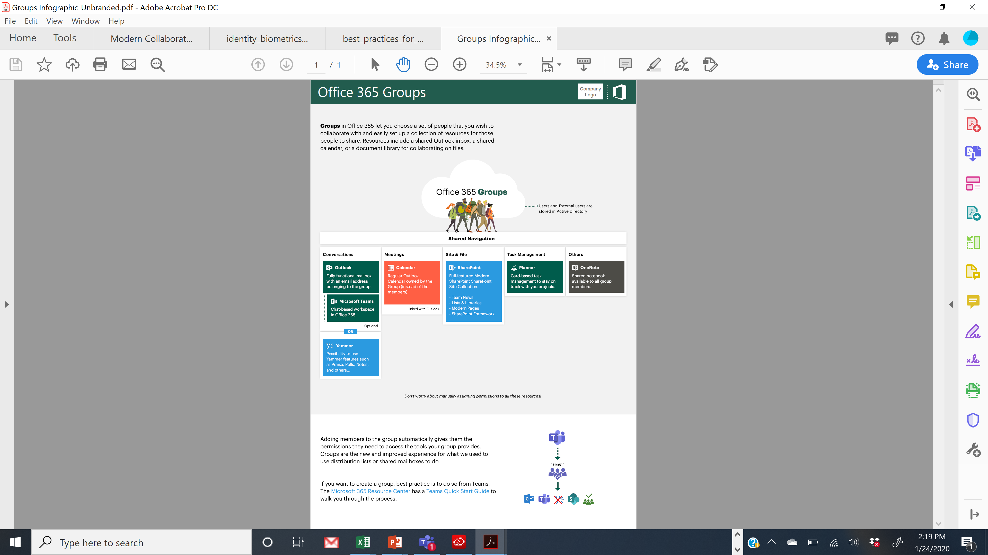
Leading Outdoor Retailer User Adoption Initiative
Office 365 Essentials
We pitched another visual design, with users and owners at the center, and created clickable titles that are geared to the action the user needs to perform to do their job.
Each heading takes the user to the resource center we built, encouraging user self-service. Note this is a user-based journey!
Understanding Office 365 Groups
There was some confusion amongst stakeholders on how groups work. An infographic was perfectly suited to visually represent how Groups work and to promote the client’s preferred method for creating groups, Teams.
100% of HQ (~4k) have moved to O365 successfully and have expedited the roll out to the larger field retail group.

